Slide 1
WORLD POPULATION ANALYSIS
VAMSHI KRISHNA
2320686

Slide 2
OBJECTIVE
Develop an ETL process using Informatica Powercenter by using the data collected from multiple sources.
To create mappings by loading the source data to the target by using the required transformations included in the mapping logics.
To perform ETL validations to the mappings implemented.

Slide 3
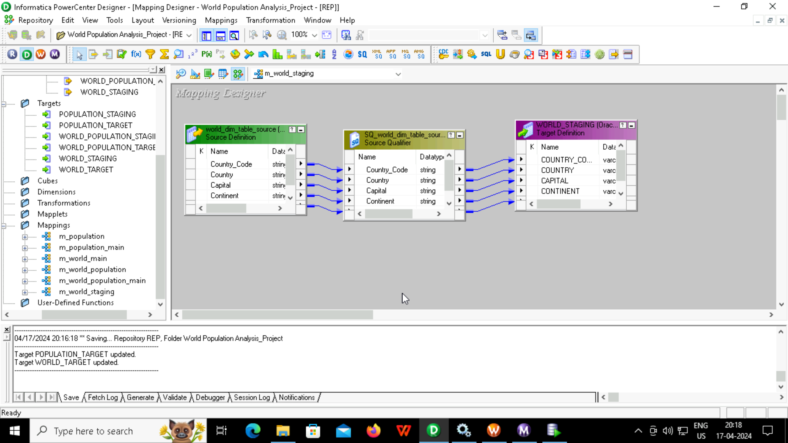
STAGING AREA MAPPING 1. COUNTRY TABLE(DIM TABLE)

Slide 4
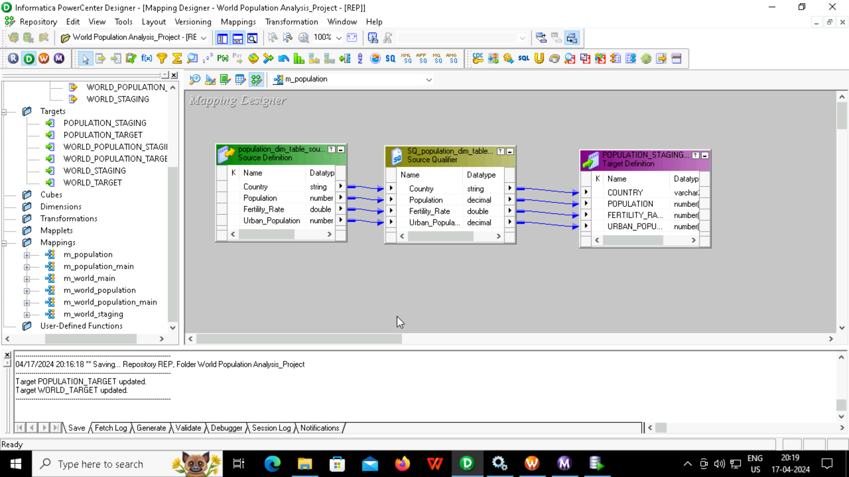
2. POPULATION TABLE(DIM TABLE)

Slide 5
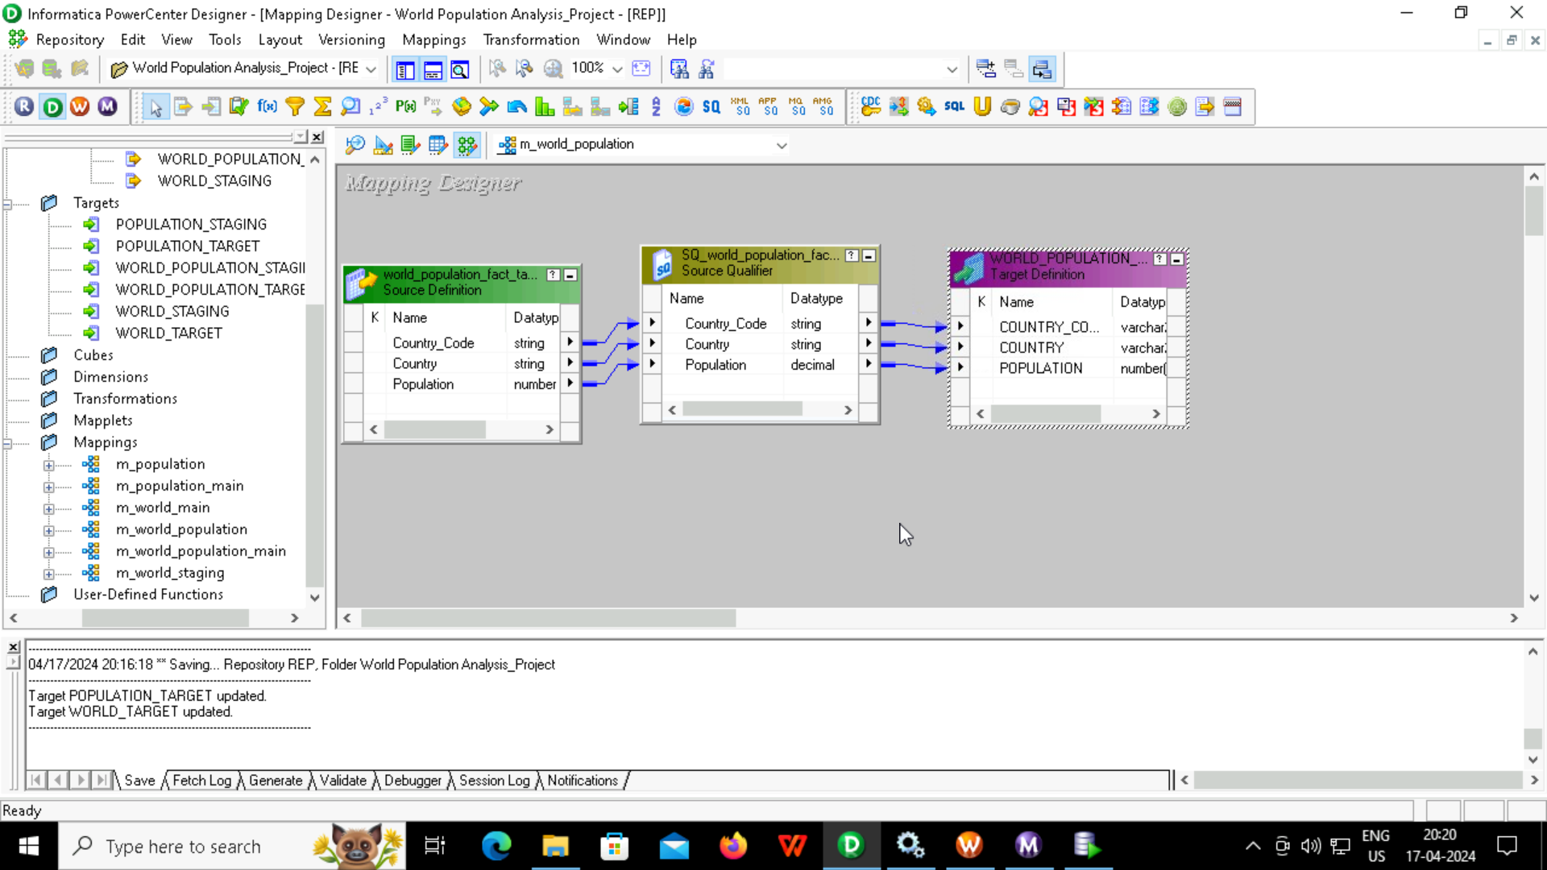
3. WORLD POPULATION TABLE(FACT TABLE)

Slide 6
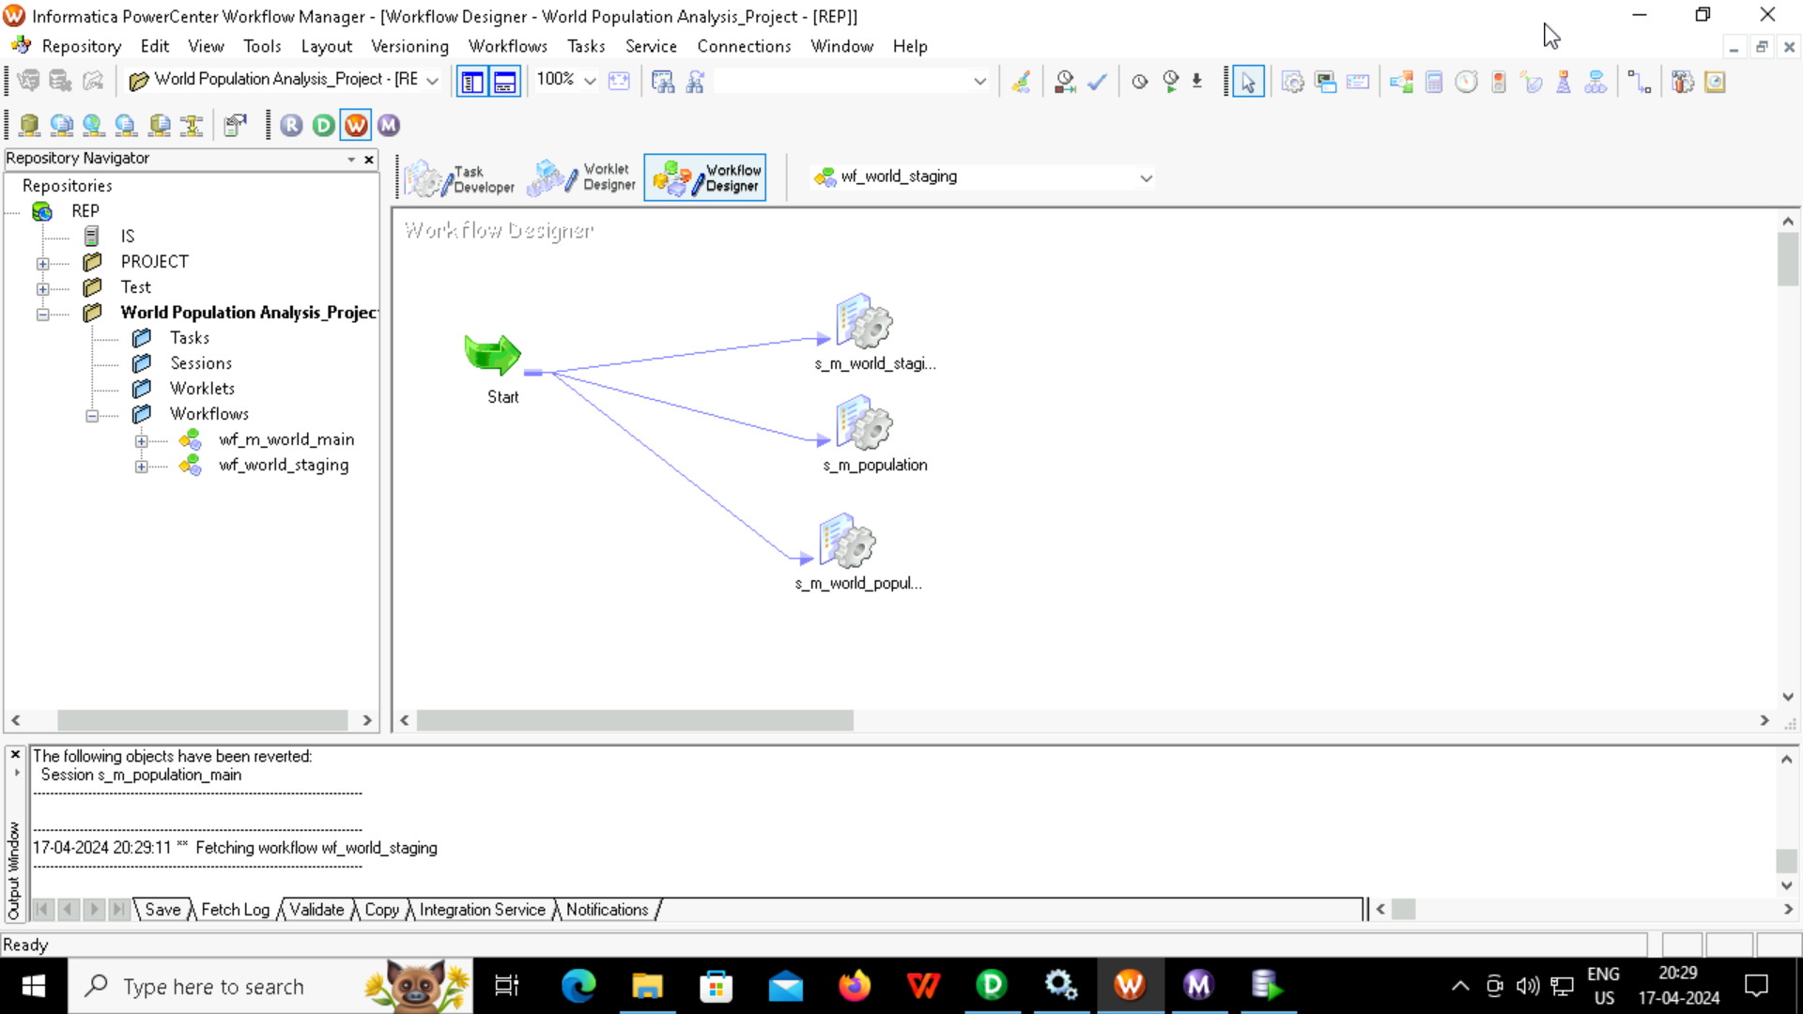
WORKFLOW FOR STAGING TABLES

Slide 7
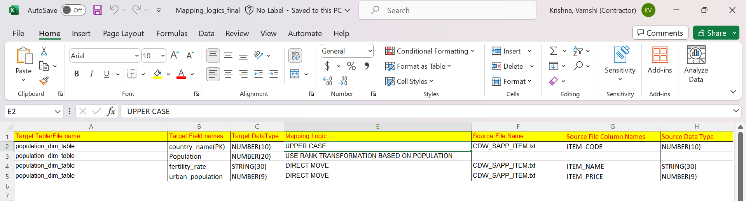
MAPPINGS 1. Country table mapping logic

Slide 8
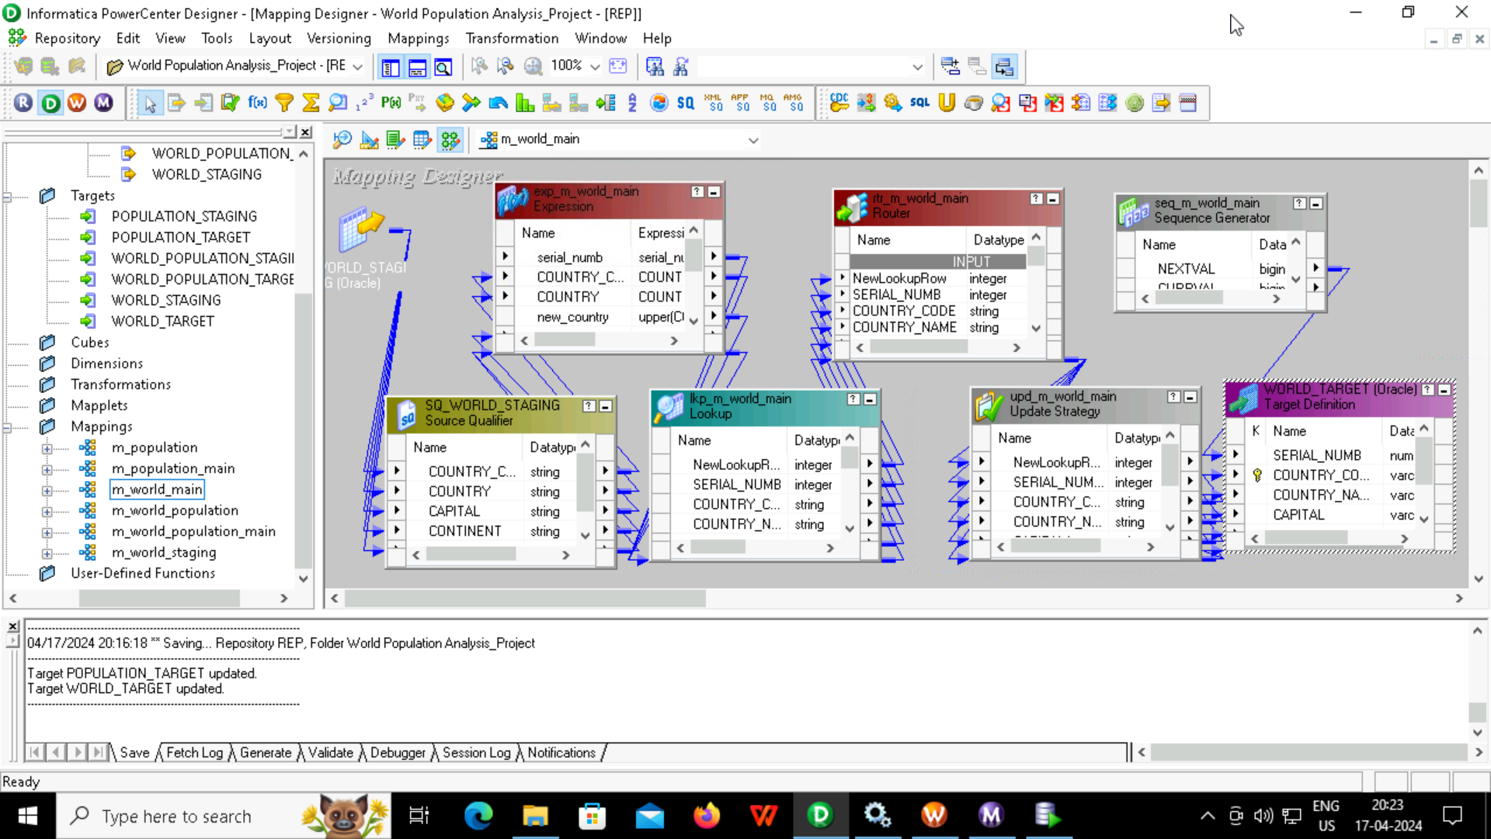
Country table mapping(Dimension table)

Slide 9
2. Population table mapping logic

Slide 10
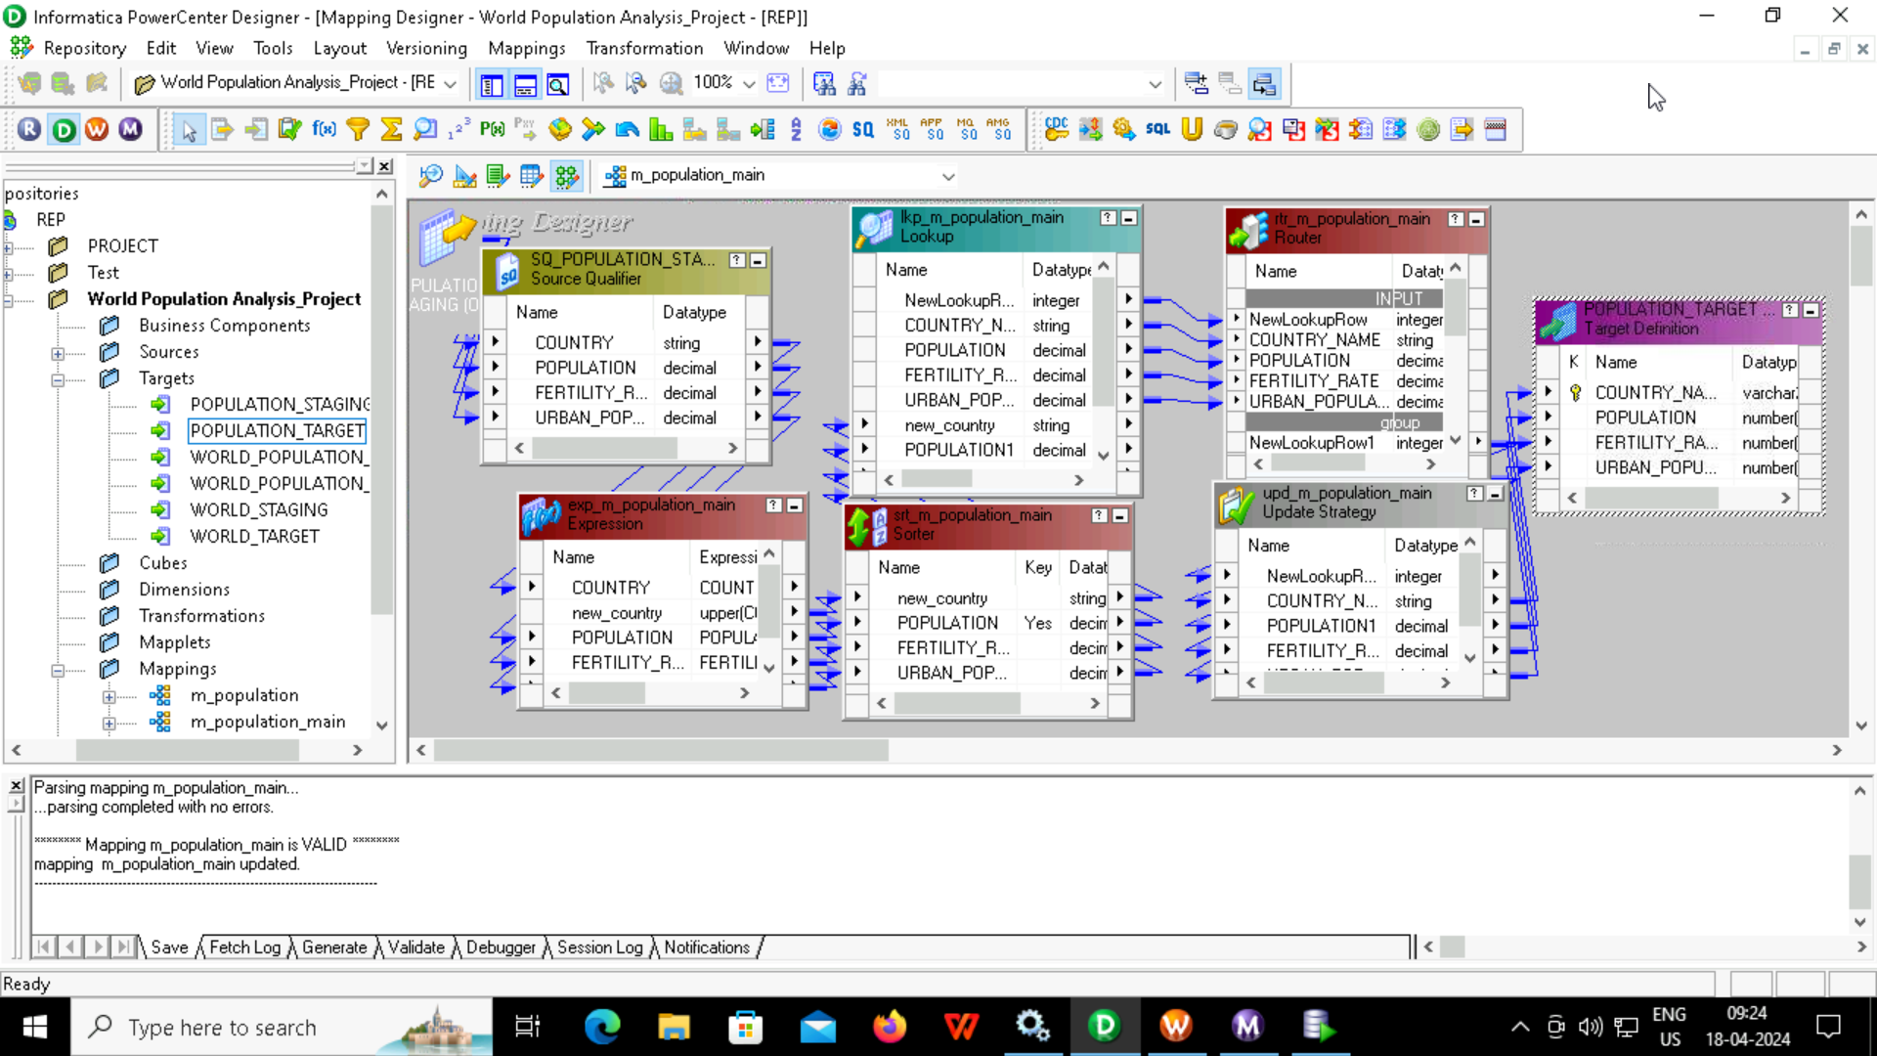
Population table mapping(Dimension Table)

Slide 11
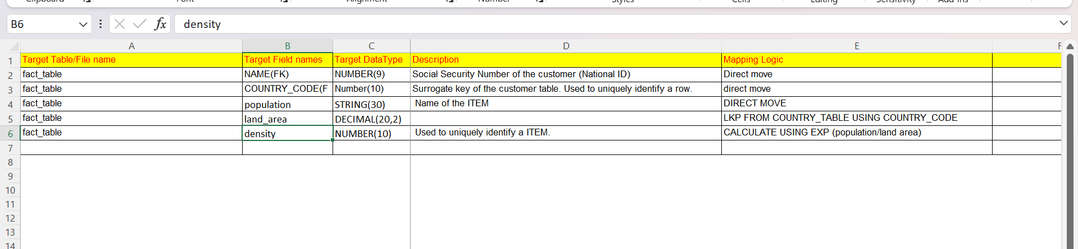
3. Fact table mapping logic

Slide 12
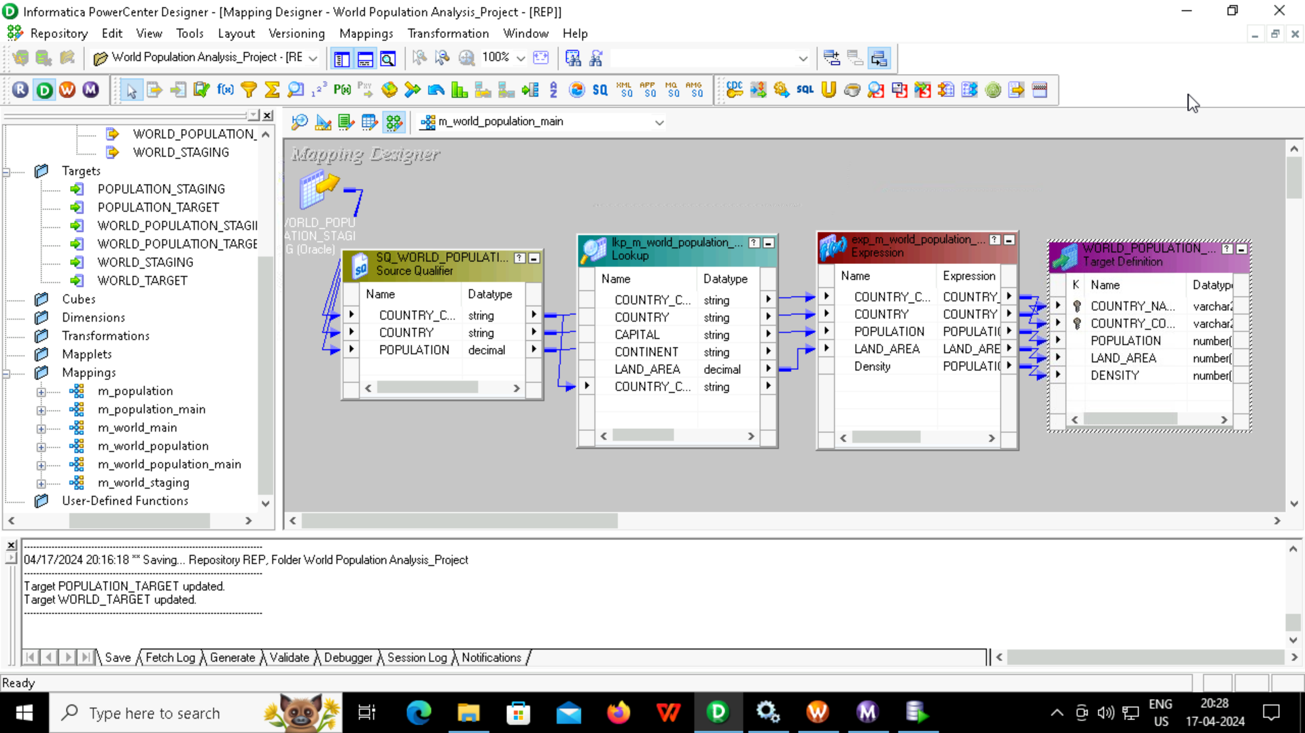
Fact table mapping

Slide 13
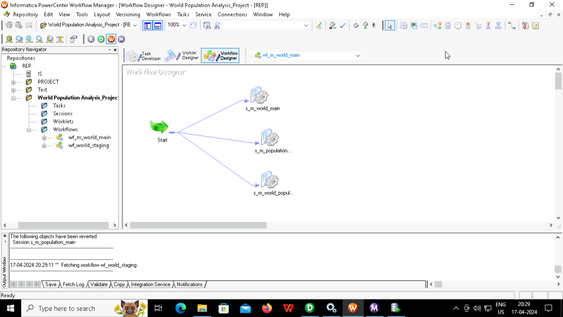
Workflow for mappings

Slide 14
Transformations used
1.For Country table(DIM table)
Source Qualifier
Lookup
Router
Update Strategy
Sequence generator
Expression

Slide 15
2. For Population table(DIM table)
Source Qualifier
Sorter
Lookup
Router
Update Strategy

Slide 16
3. For Fact table
Source Qualifier
Expression
Lookup

Slide 17
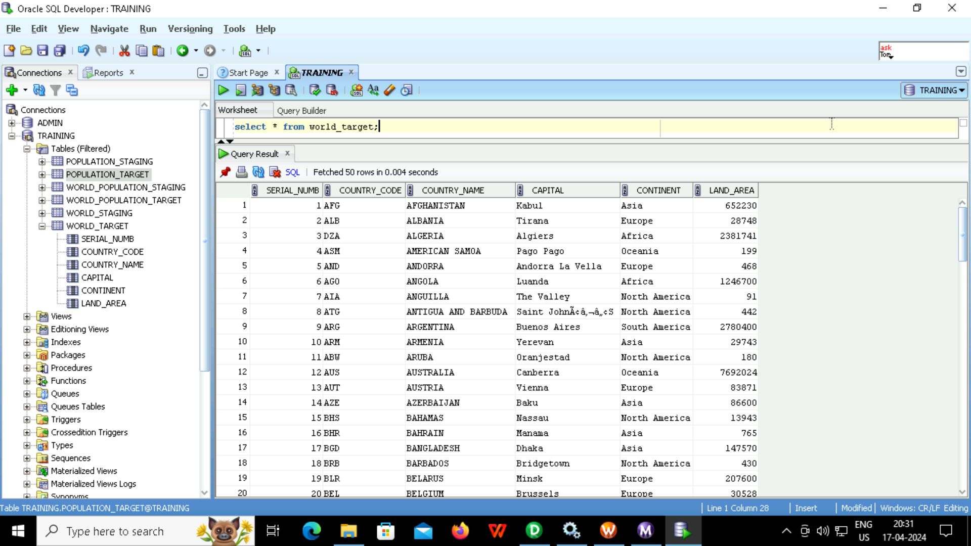
RESULTS
1. Country table

Slide 18
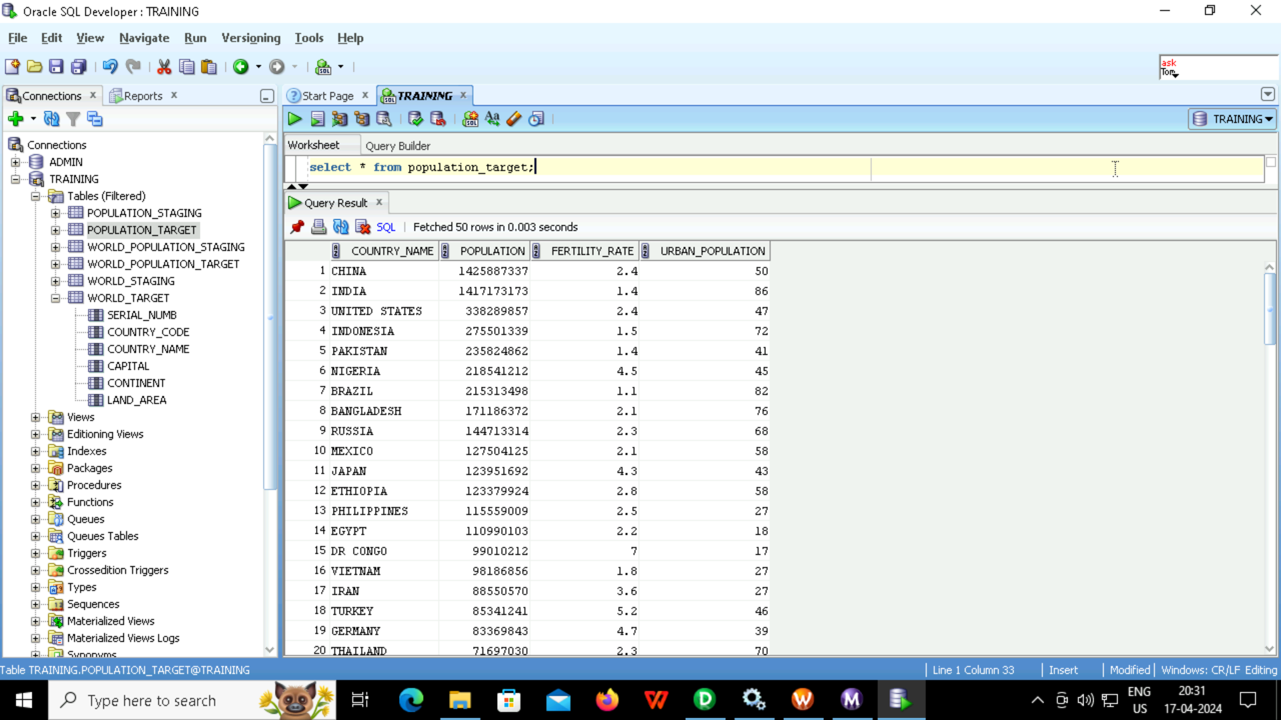
2. Population table

Slide 19
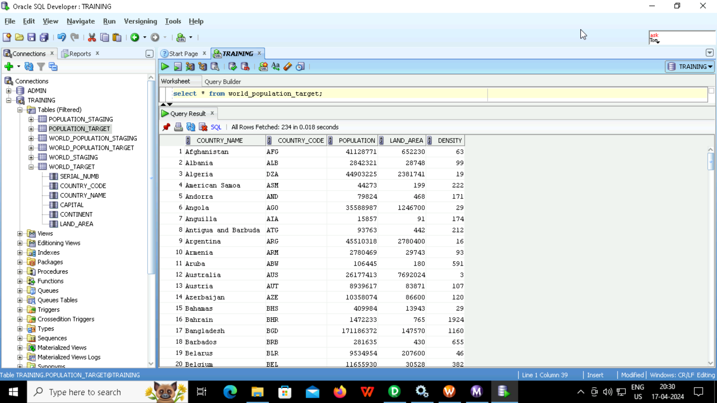
3. For Fact table

Slide 20
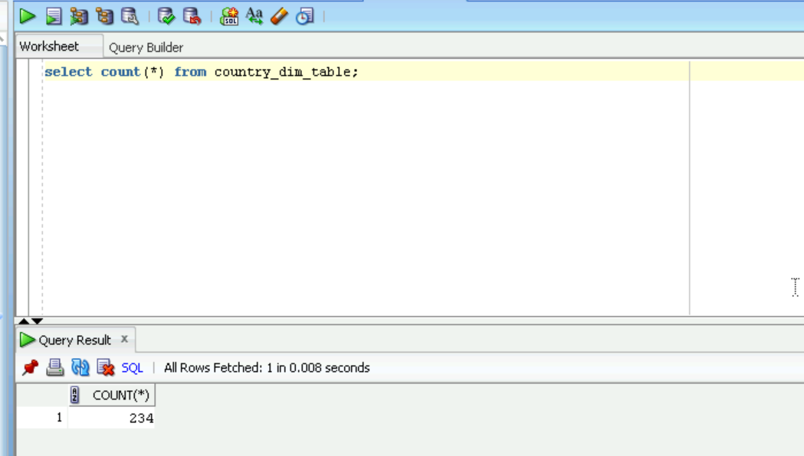

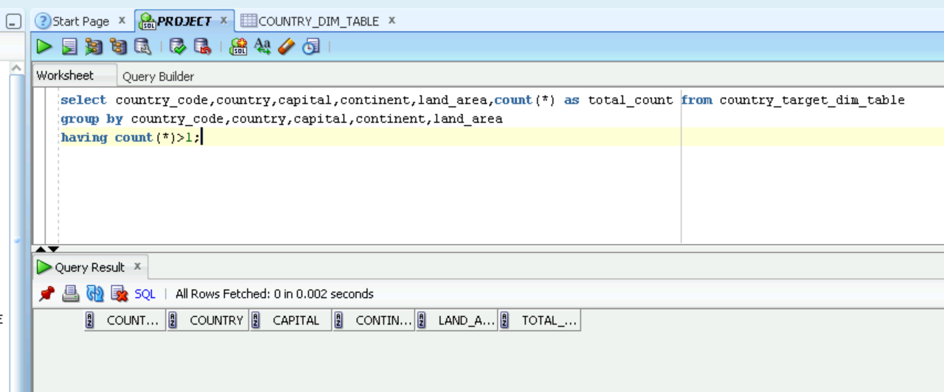
Validations
Country Table
Count and duplicate validation:

Slide 21
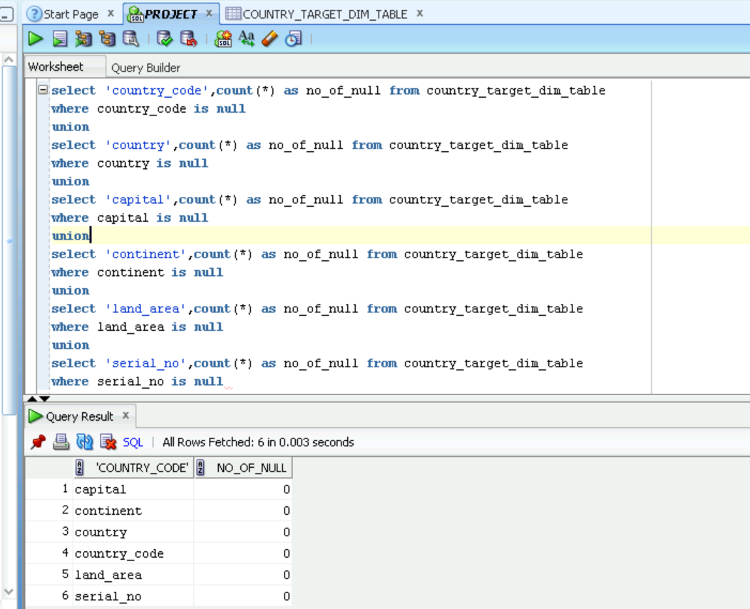
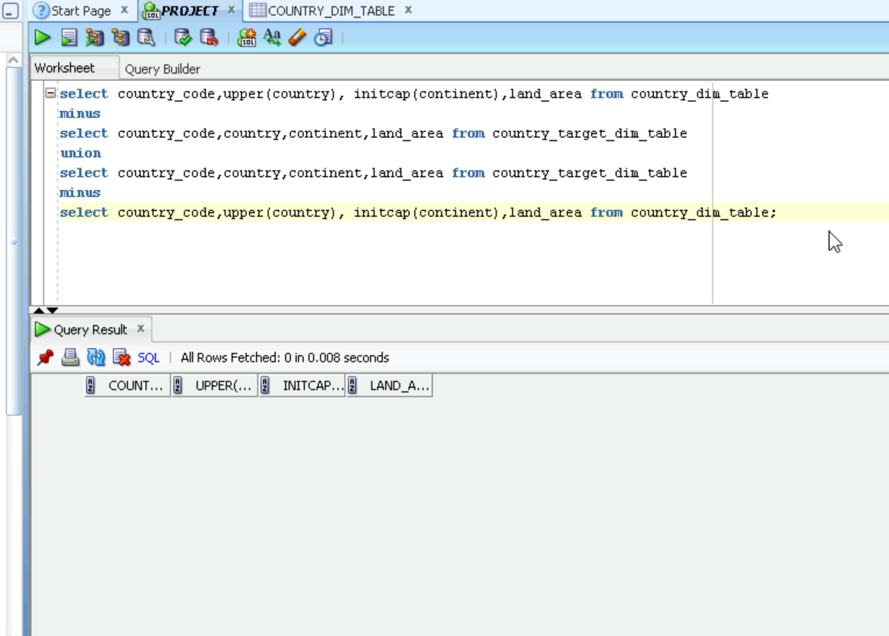
Null Validation and Minus Query :

Slide 22


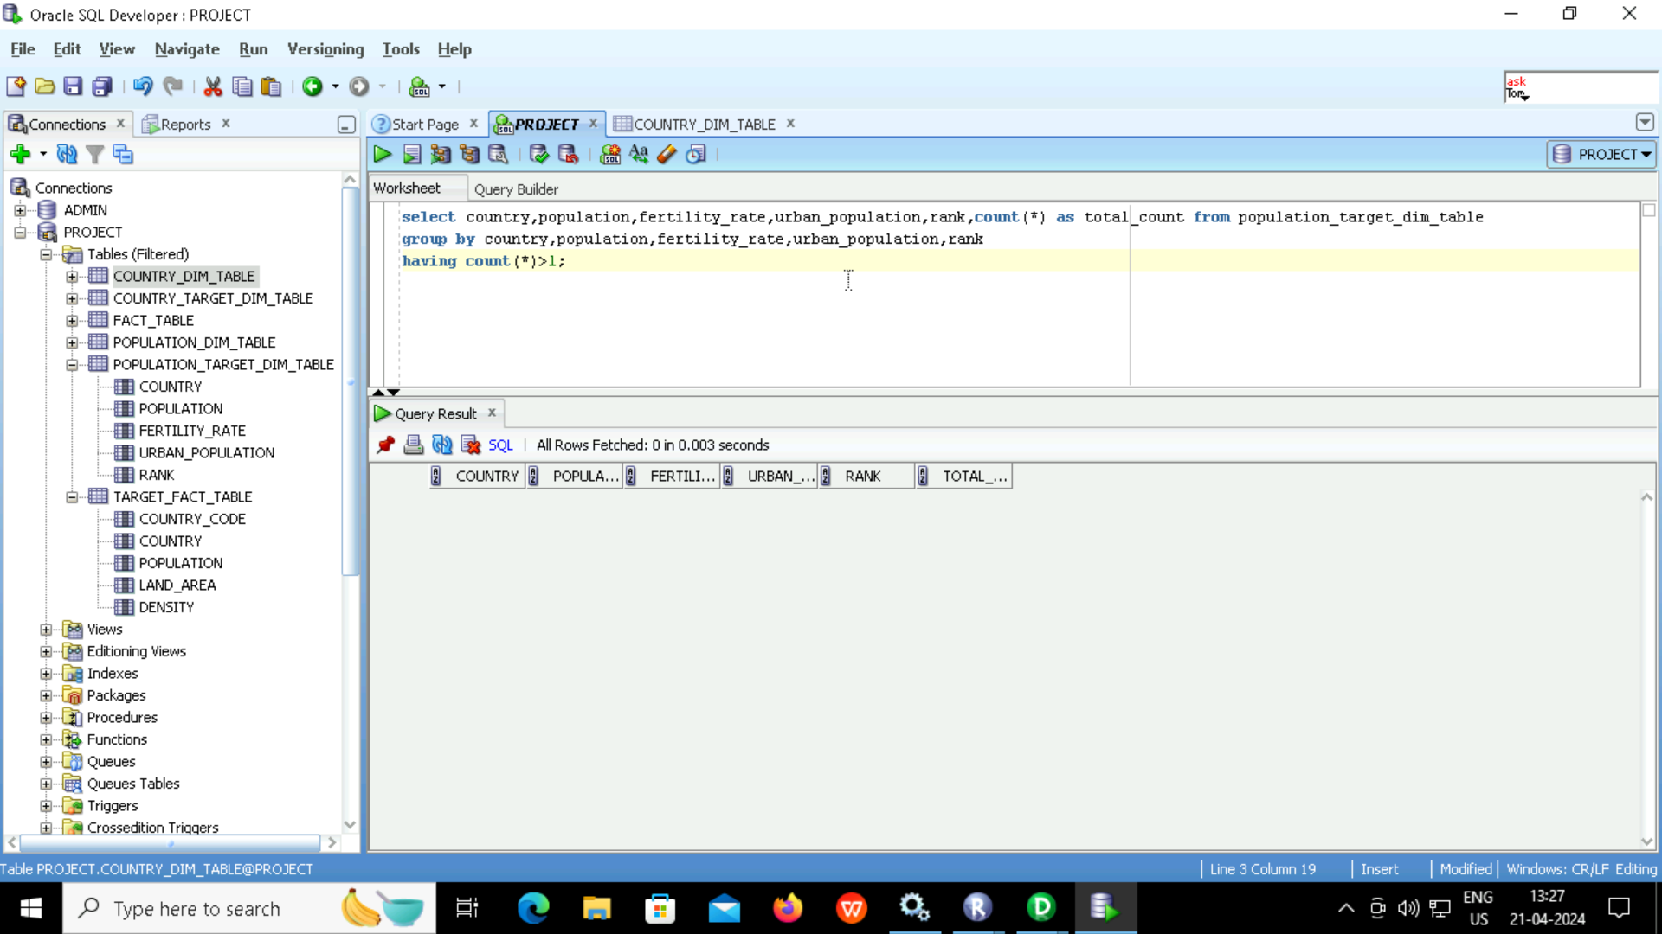
Population Table
Count and duplicate validation:

Slide 23
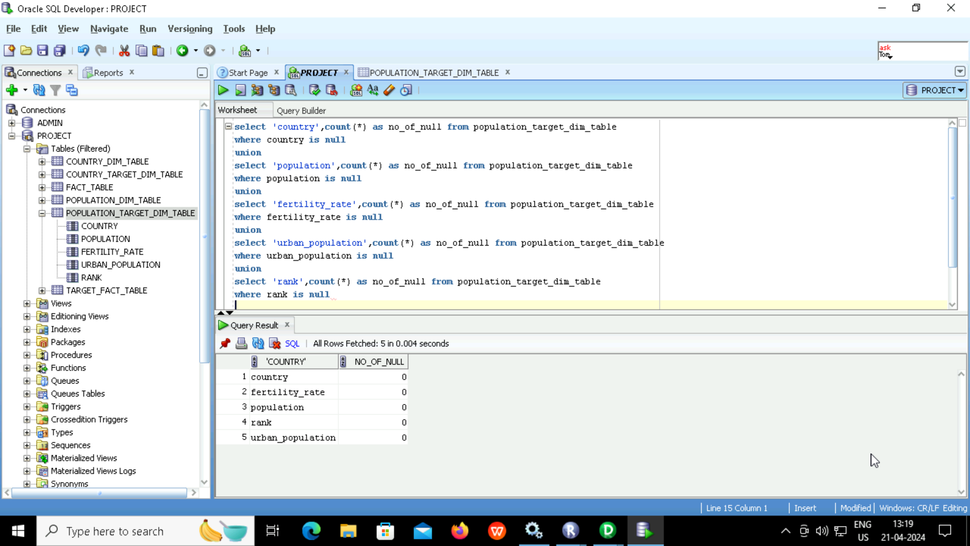
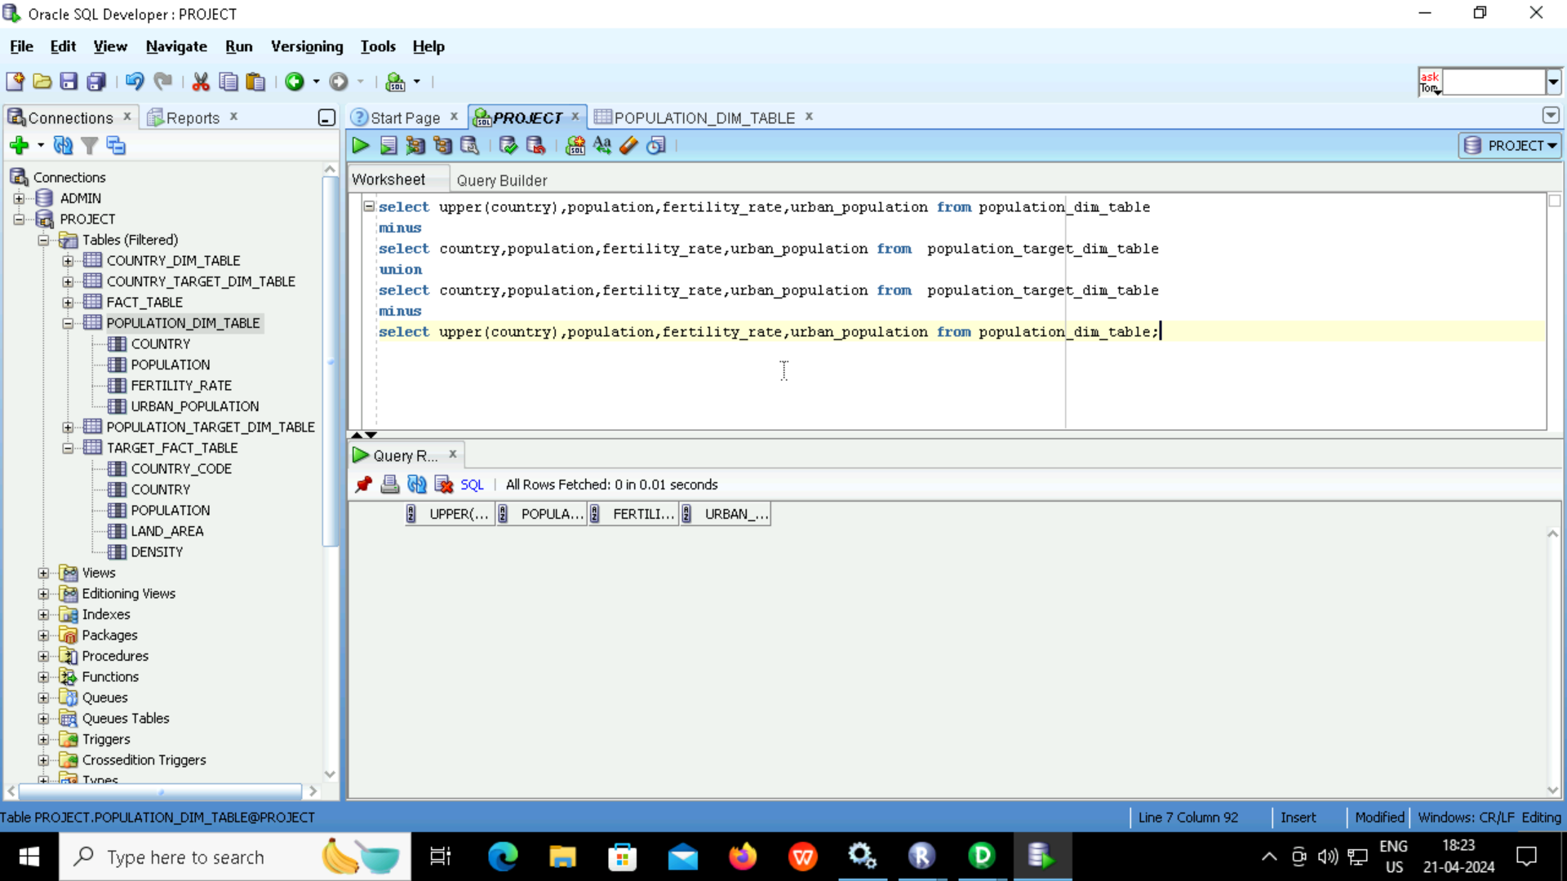
Null Validation and Minus Query :

Slide 24
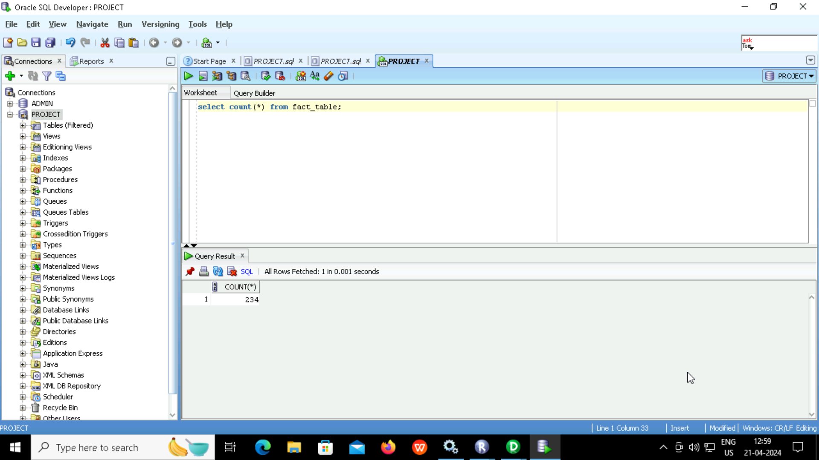


Fact Table
Count and duplicate validation:

Slide 25
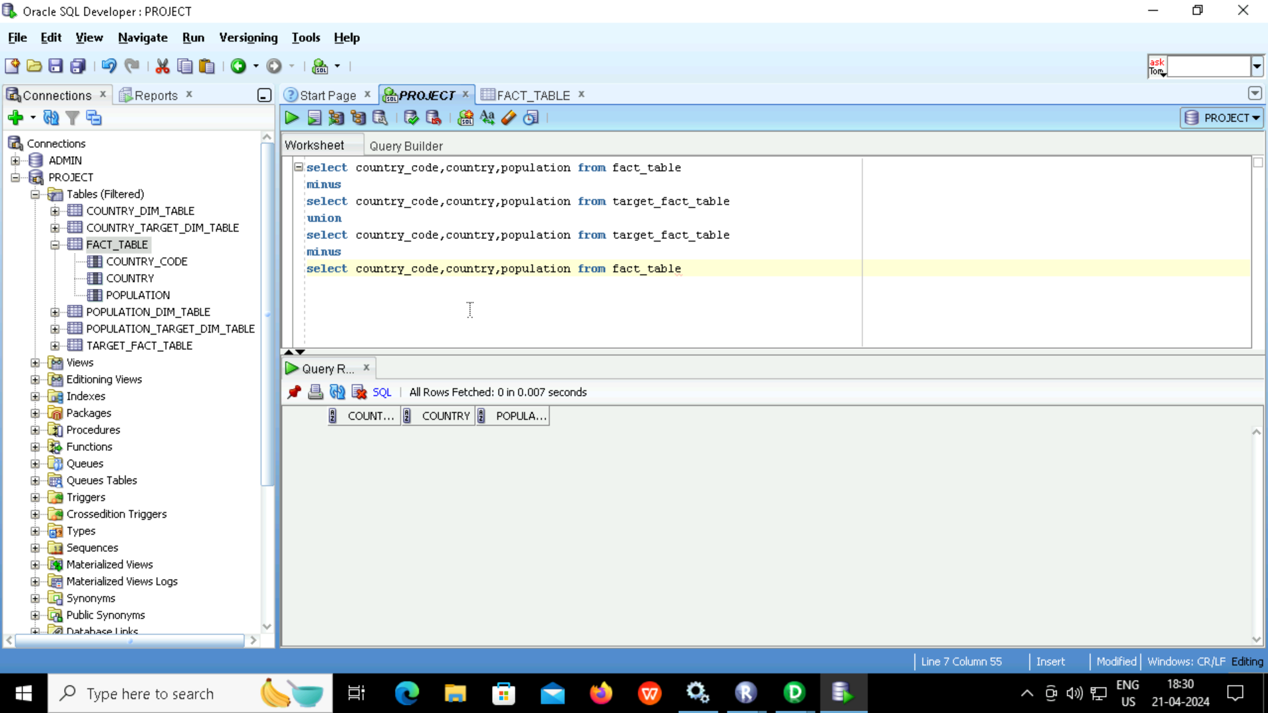
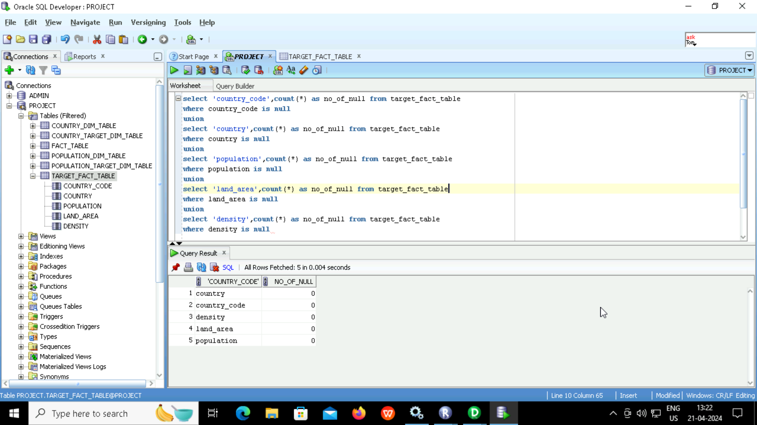
Null Validation and Minus Query :

Slide 26
There are 2 dimension and one fact table
Country and Population tables are the dimension tables and world population table is the fact table
I have calculated the density of all 234 countries by dividing the population with land area using the required transformations
Conclusion:

Slide 27
THANK YOU

